Slide 1

By Anuj Singh
Business Analyst Career Program - Capstone Project

Slide 2

Introduction:
In today's data-driven business landscape, making informed decisions is crucial for sustainable growth and success. This project, "Business Analytics on Western Countries Financial Data," delves into the world of financial data analysis to uncover valuable insights that can drive strategic actions. By harnessing the power of tools such as SQL, Excel, Power BI, and possibly Tableau, we aim to unravel patterns, trends, and correlations within the financial data of Western countries.

Slide 3
Objectives
Data Exploration: Through thorough examination and visualization of the dataset, we aim to identify underlying trends, anomalies, and potential areas of interest within the financial data.
Insight Generation: By employing various analytical techniques, we intend to extract meaningful insights that can aid in understanding the financial performance of Western countries.
Dashboard Creation: Using Power BI and optionally Tableau, we will design an interactive dashboard that presents key findings and metrics in a visually engaging manner.
Business Implications: The insights gained from this analysis will be translated into actionable recommendations for businesses operating in Western countries, enabling them to make well-informed decisions.

Slide 4
Dataset Source and Key Features
The dataset used for this project originates from diverse Western countries and encompasses a range of financial attributes. The key features within the dataset include:
Segment: The classification of market segments.
Country: The Western country associated with the financial data.
Product: The product or service offered.
Discount Band: The level of discounts applied.
Units Sold: The quantity of units sold.
Manufacturing Price: The cost of producing each unit.
Sale Price: The price at which units are sold.

Slide 5
Gross Sales: The total revenue before accounting for discounts and costs.
Discounts: The monetary value of discounts applied.
Sales: The net revenue after discounts.
COGS (Cost of Goods Sold): The cost of producing the sold units.
Profit: The net profit obtained from sales.
Date: The date of the transaction.
Month Number: The numeric representation of the month.
Month Name: The textual representation of the month.
Year: The year in which the transaction occurred.

Slide 6
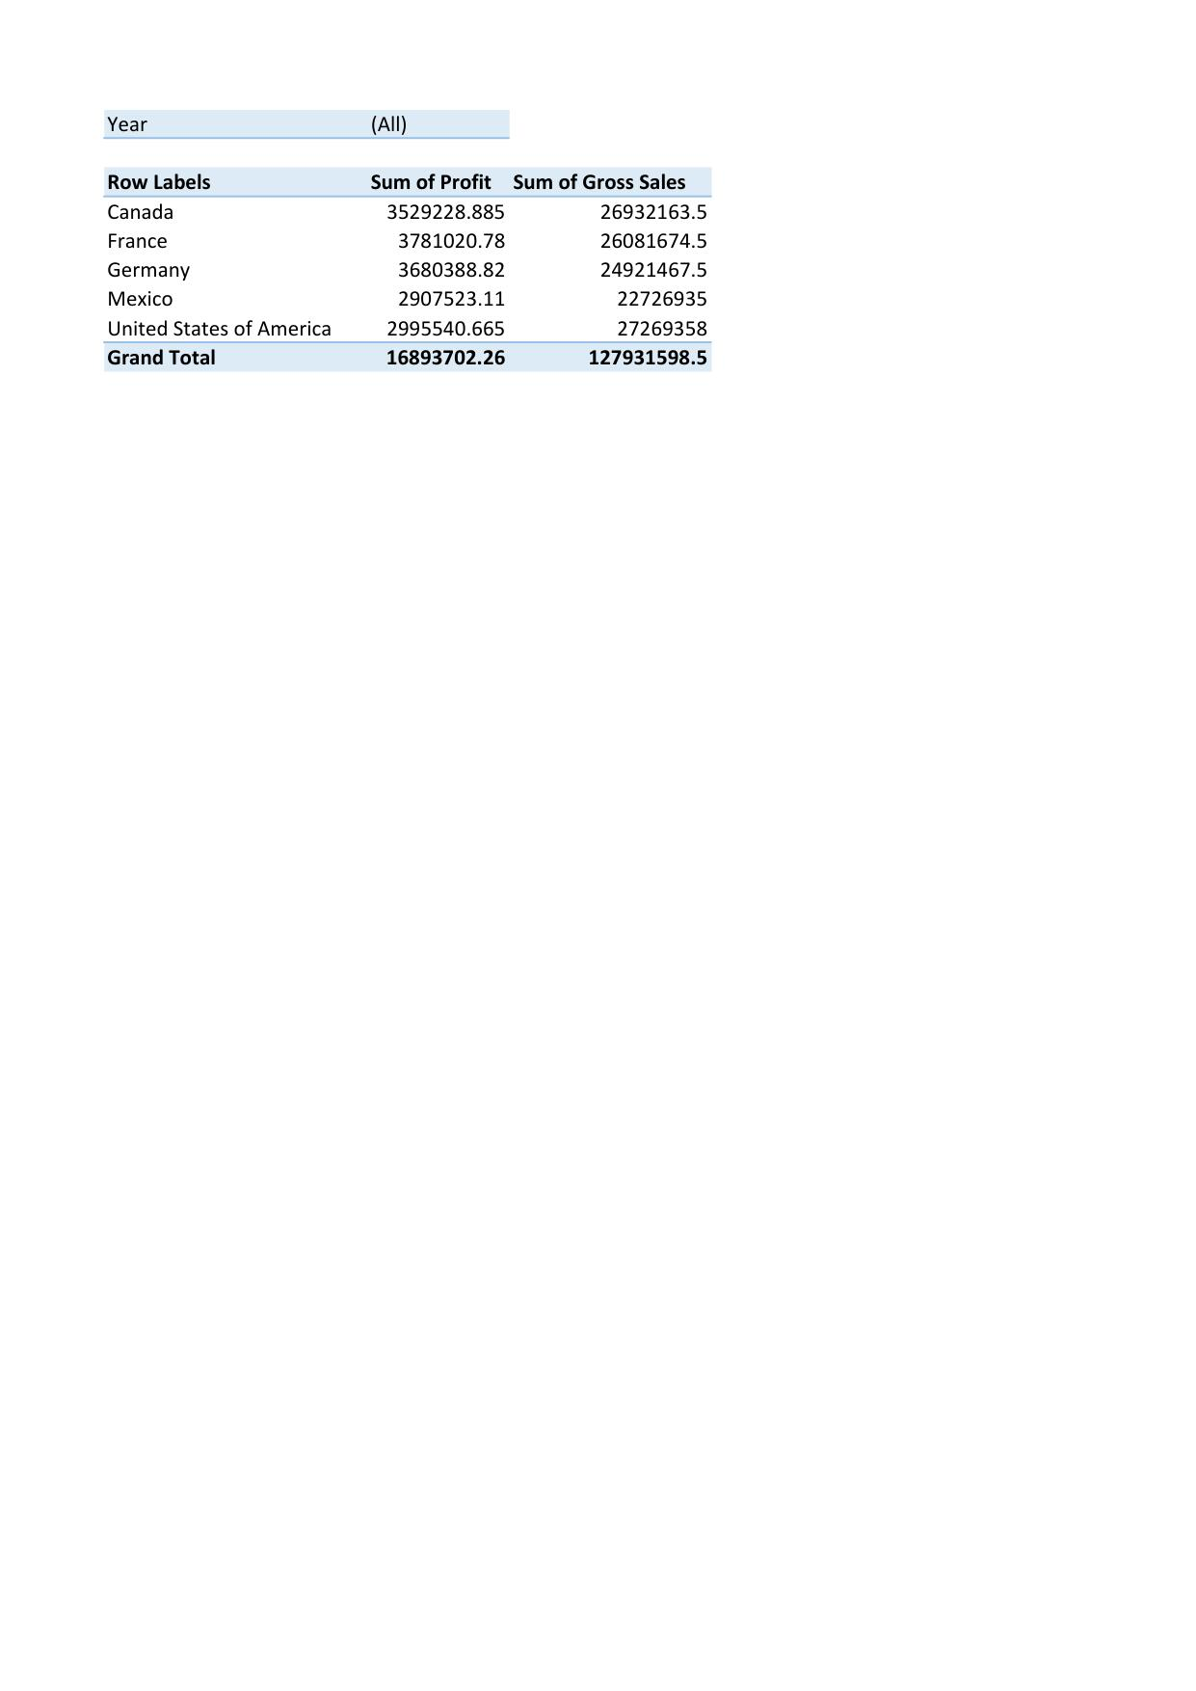
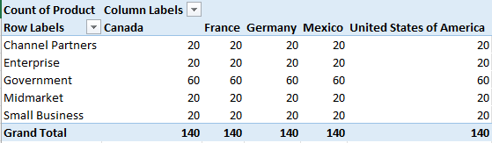
Country wise products in all segments

Slide 7
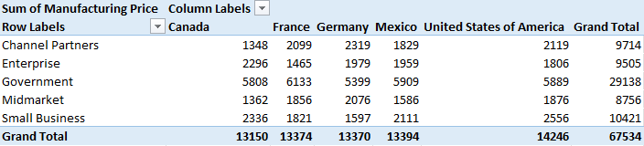
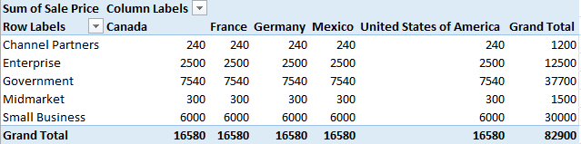
Country wise difference between manufacturing price and sales price in all segments

Slide 8
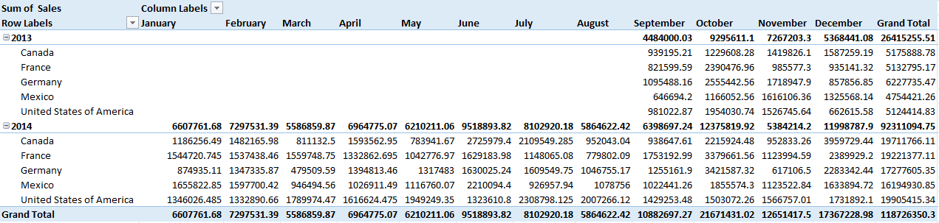
Sales increase by month on month

Slide 9
Total sales increase in 2013 to 2014

Slide 10
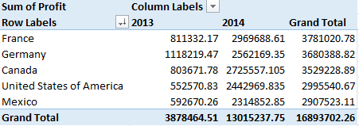
Total profit in descending order.

Slide 11
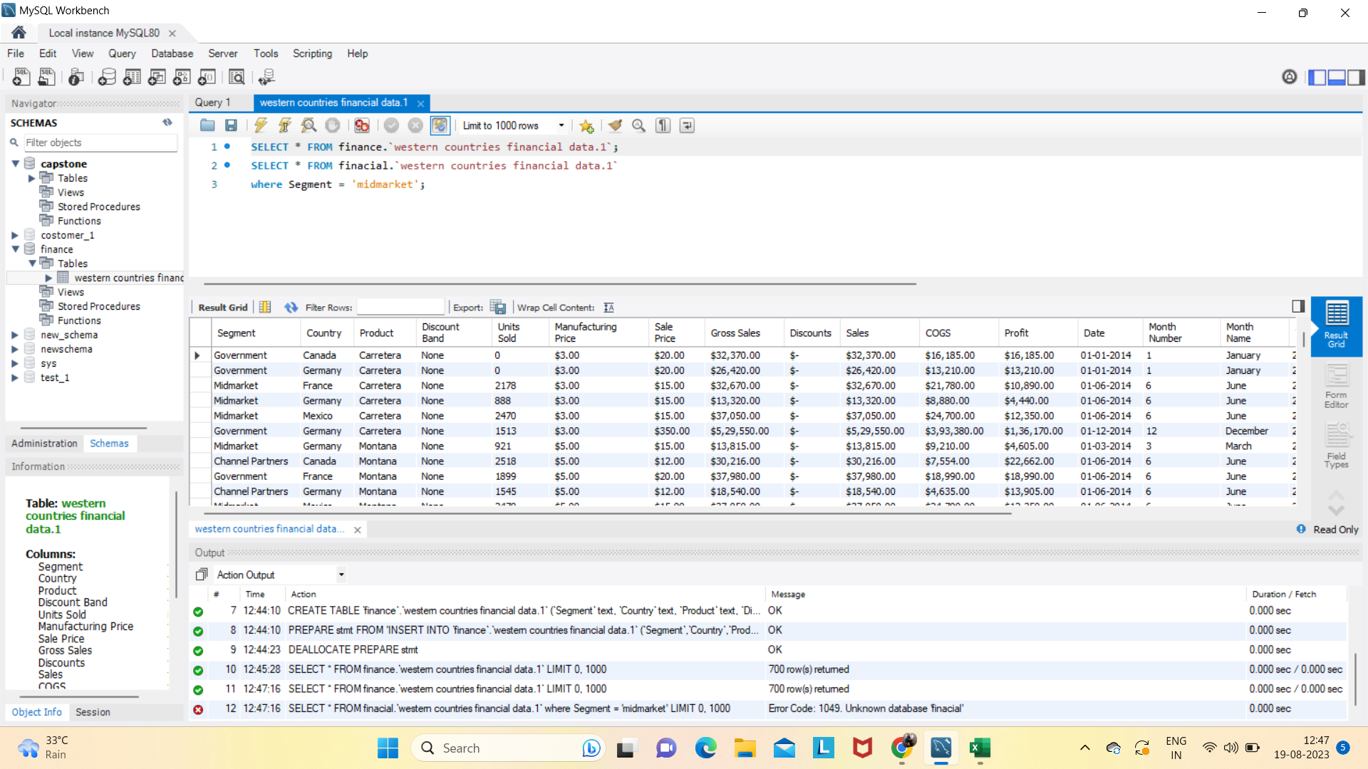
Data insert in SQL

Slide 12
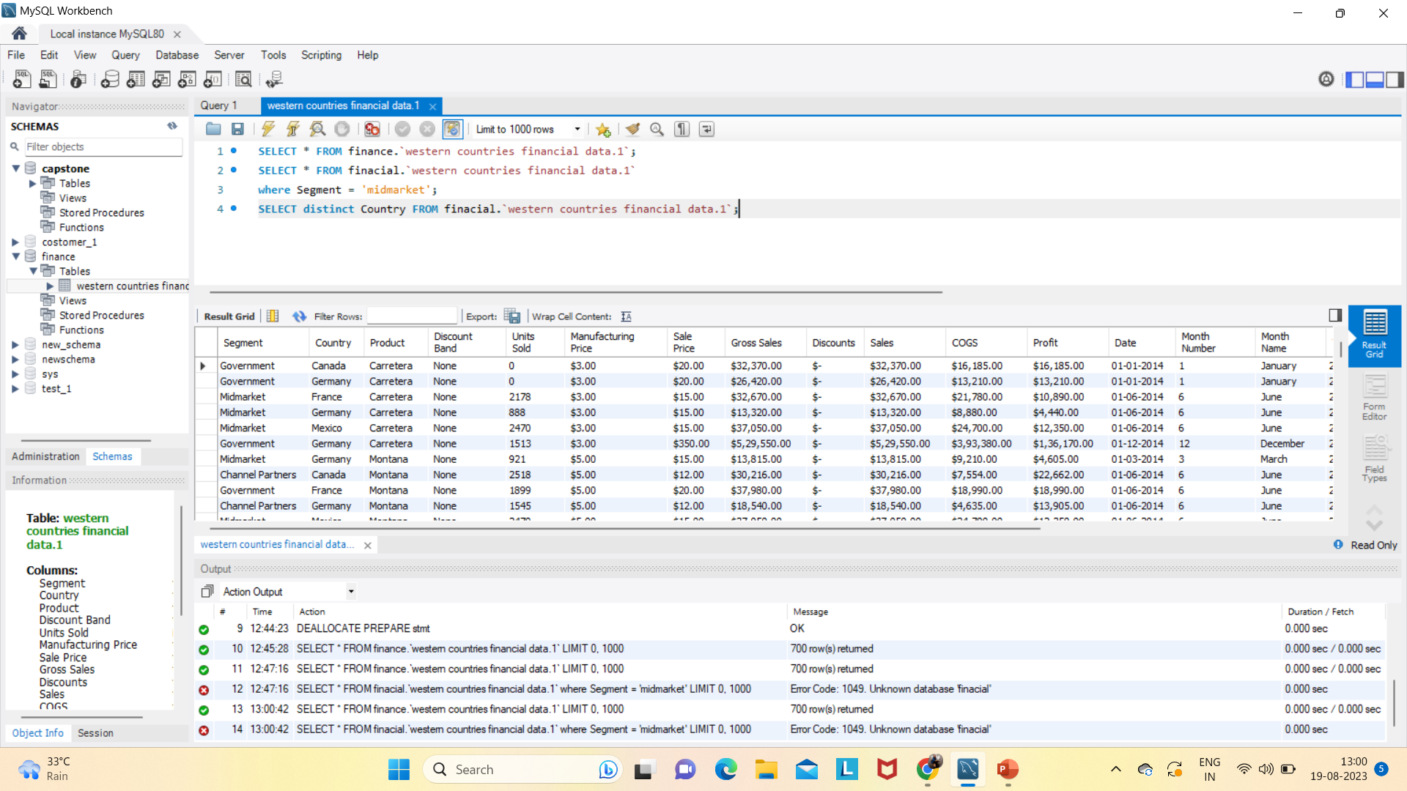
Running Queries IN SQL

Slide 13
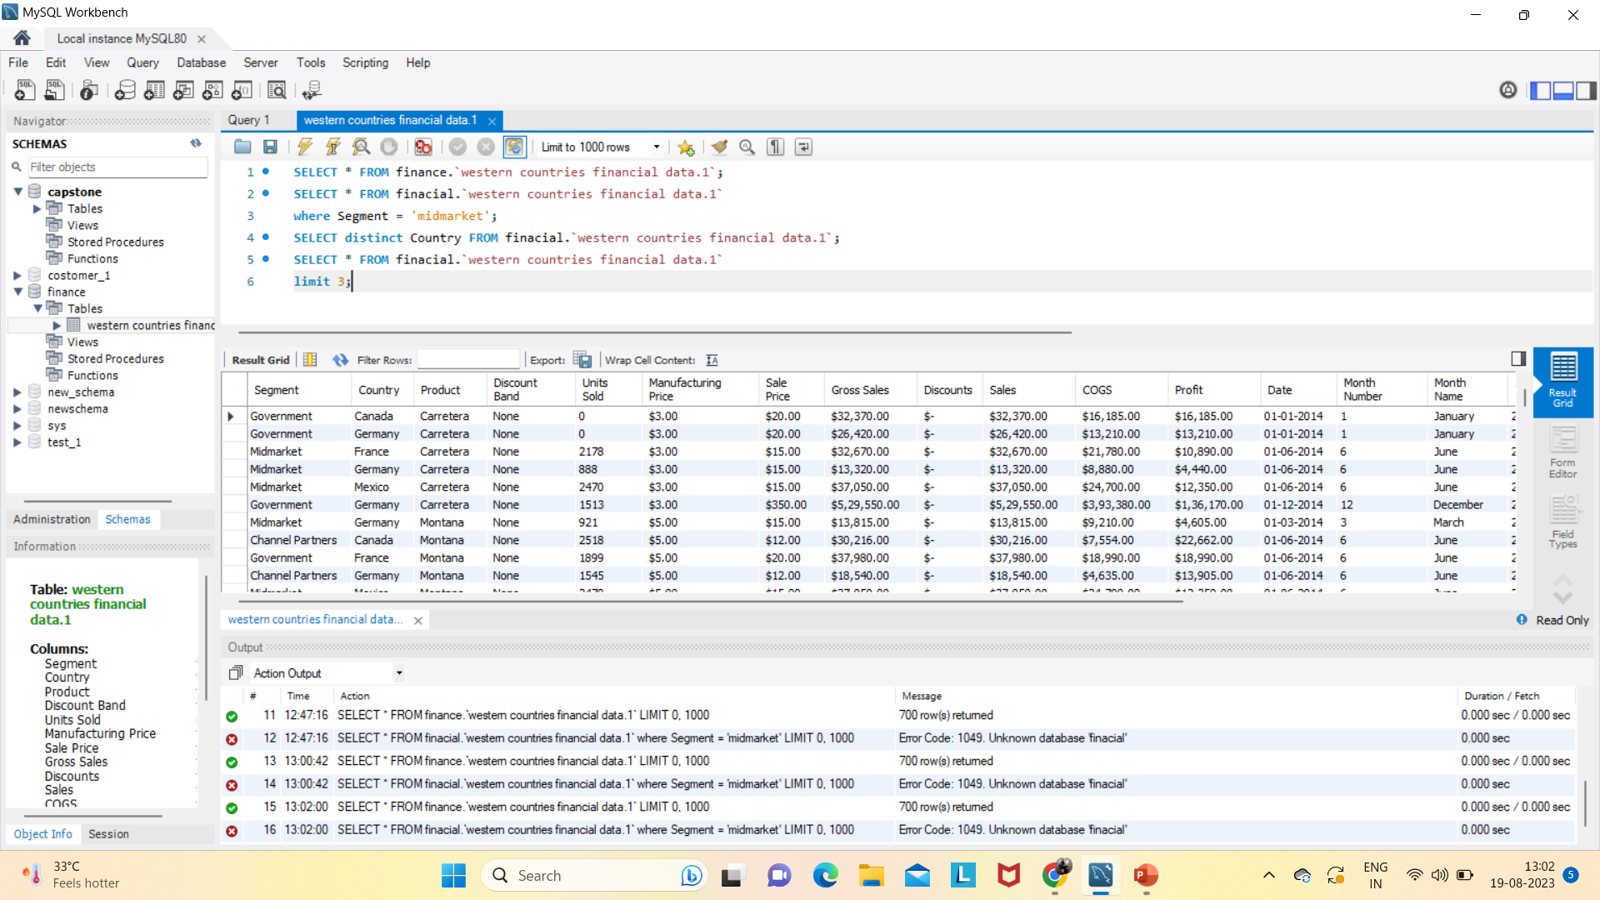

Slide 14
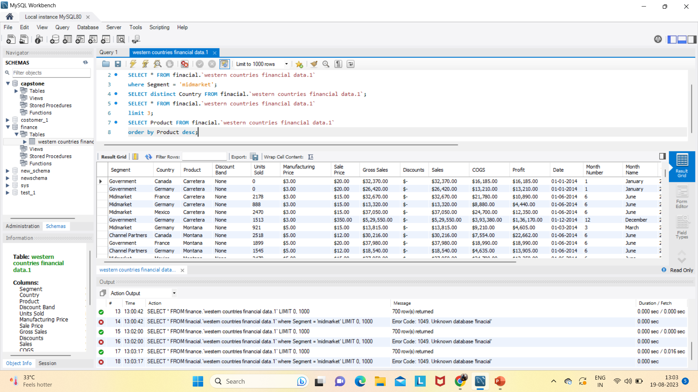

Slide 15
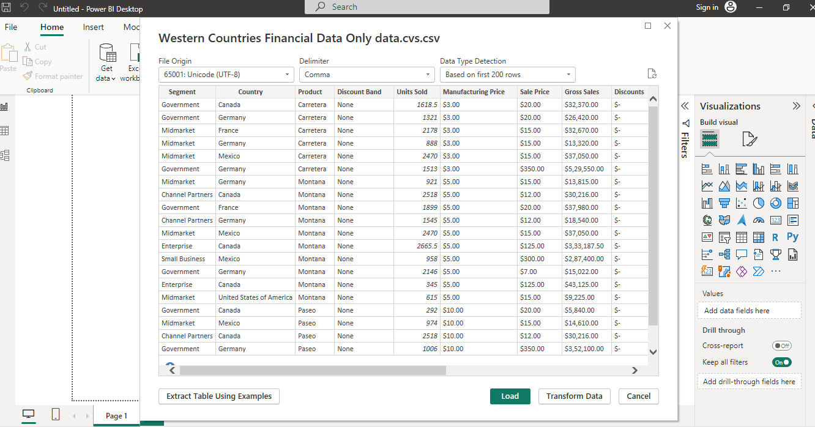
Import the Data from the SQL Database into Power-BI

Slide 16
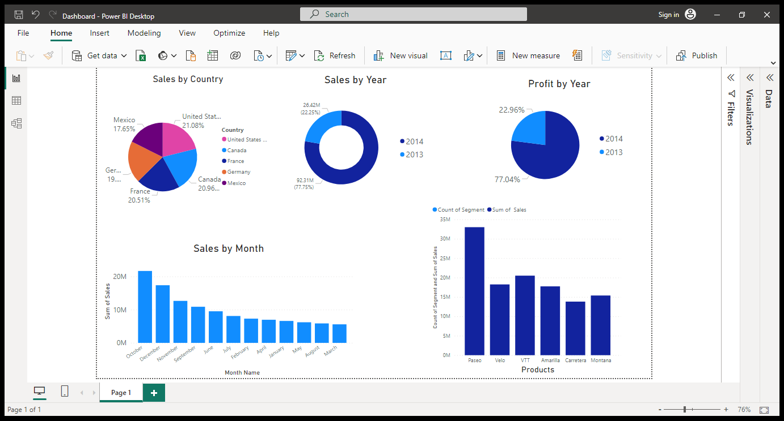
Power BI Dashboard

Slide 17
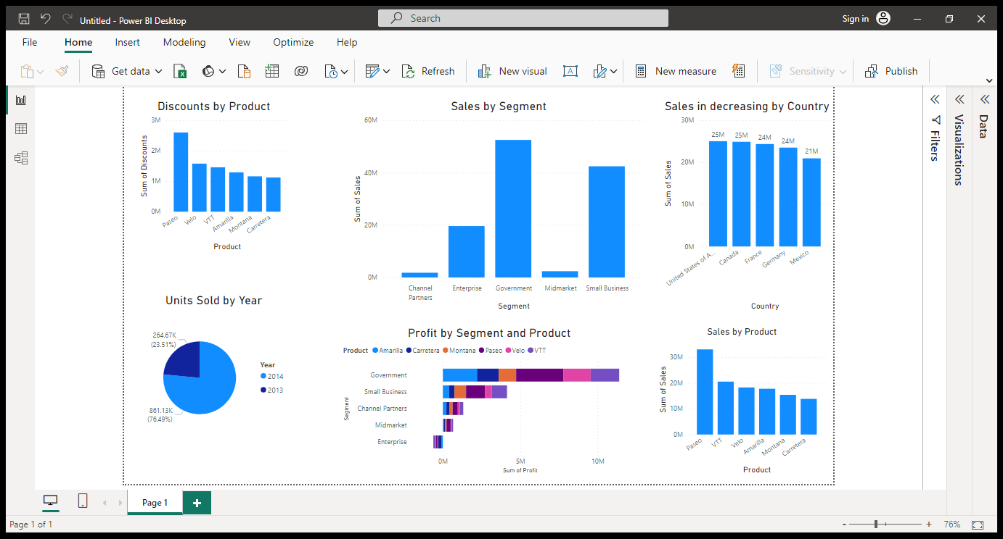
Power BI Dashboard

Slide 18
Conclusion
This project delves into the dataset's intricacies to uncover meaningful insights that can assist businesses in making informed decisions. By combining various analytical techniques and visualization tools, we aim to provide a holistic view of financial performance, enabling stakeholders to navigate the complexities of Western markets with confidence.
As we proceed through the project, we will apply data manipulation, visualization, and analysis techniques to extract valuable insights from the dataset. Our goal is to empower businesses with actionable information that can drive growth, optimize operations, and enhance profitability in the dynamic landscape of Western countries' economies.

Slide 19
Endnotes
Reference Links:-
Excel file, Power-BI file: Western-Countries-Financial-Data-Only-data/ at main · anujsingh1195/Western-Countries-Financial-Data-Only-data (github.com)

